Slide 1
Comparative Evaluation of Deep Learning Models for Brain Stroke Detection using Neuroimaging Data
Supervised by
X
Associate Professor
Dept. of CSE, IIUC
Presented by
A (C000000)
B (C000000)
C (C000000)
Dept. of CSE, IIUC

Slide 2
Table of Contents
Research Background
Research Gap
Research Objective
Motivation
Challenges
Related Works
Proposed Framework
Datasets
Simulation and Experimental Results
Conclusion
Future Works
References

Slide 3
Research Background
Stroke happens when blood flow to the brain is blocked and can quickly cause permanent damage.
Fast and accurate diagnosis is critical to improve survival and recovery.
CT scans are commonly used, but reading them depends on expert radiologists and time.
Deep learning (CNNs) can automatically analyze images and help detect stroke faster and more reliably.

Slide 4
Research Gap
Evaluate only one CNN architecture
Use different datasets and evaluation protocols
Provide limited comparison of accuracy vs efficiency
Rarely analyze false negatives (clinically critical)

Slide 5
Objectives
To develop and automated stroke detection system using deep learning models
To perform a comparative analysis of state-of-the-art convolutional neural network models, including VGG16, ResNet, DenseNet-201, and EfficientNet, in the context of stroke detection.
To evaluate model performance using standard classification metrics to ensure robust and balanced assessment.
To identify the most clinically reliable model by analyzing its diagnostic consistency

Slide 6
Motivation
Stroke requires immediate diagnosis
Delays increase disability and mortality
Hospitals may lack expert radiologists 24/7
Al can assist in rapid screening and decision support

Slide 7
Challenges
Limited labeled medical data
Class imbalance (fewer stroke cases)
Subtle early-stage visual patterns
Noise and varying scan quality
Hing computational demand
Lack of interpretability of CNN decisions

Slide 8
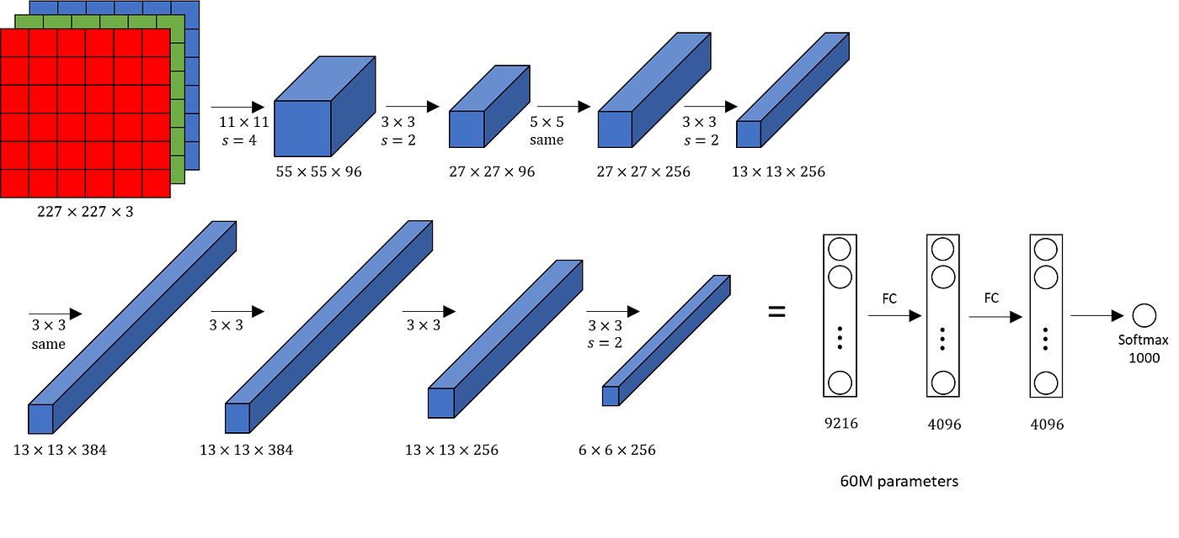
Related Works
Early breakthroughs in deep learning such as Alex Krizhevsky’s AlexNet demonstrated that convolutional neural networks could automatically learn hierarchical image features, outperforming handcrafted approaches.
Later architectures like VGG16, ResNet, DenseNet, and EfficientNet improved depth, connectivity, and computational efficiency.
These models became the backbone of many medical image classification systems.

Slide 9
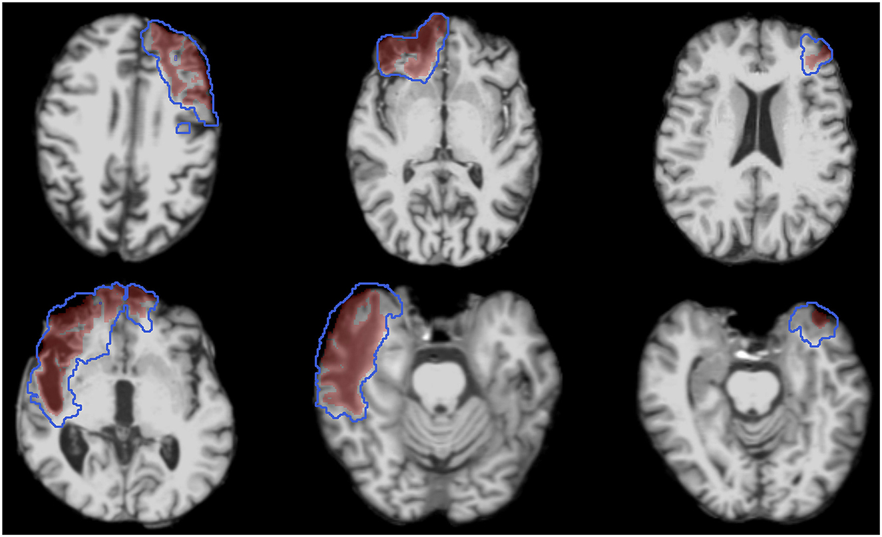
Related Works (cont.)
Studies such as the ISLES Challenge showed that CNN-based systems can successfully segment ischemic stroke lesions from brain scans.
Researchers proved that multi-scale feature extraction improves the detection of small abnormal regions that are difficult for human observers.

Slide 10
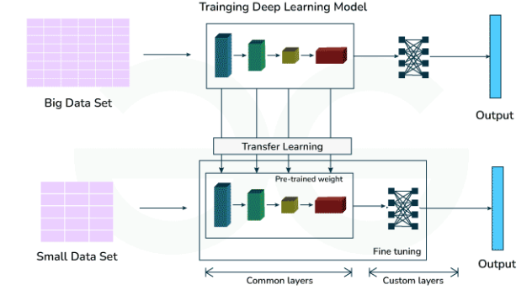
Related Works (cont.)
Because medical datasets are small, many researchers adopt transfer learning from models pretrained on ImageNet.
This allows networks to reuse low-level visual knowledge (edges, textures) and adapt to clinical tasks with limited data.

Slide 11
Dataset
Collected of different hospitals database
Two classes: Stroke and Normal
Patient diversity (Improves Generalization)
Split into training, testing and validation
Augmentation used to reduce imbalance

Slide 12
Dataset (cont.)
Training samples 11756
Validation samples 2939
Testing samples 5304
Number of classes: 2
Class Labels:
  Normal -> 0
  Stroke -> 1

Slide 13
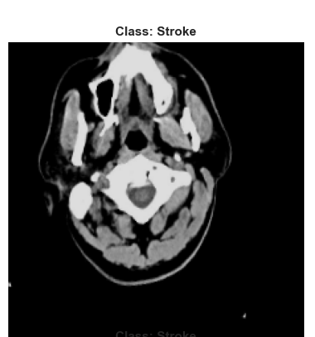
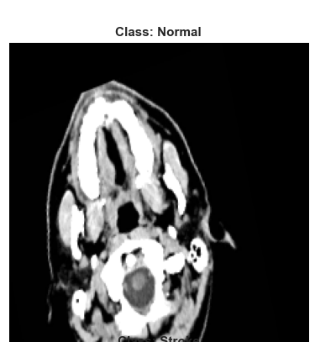
Dataset (cont.)

Slide 14
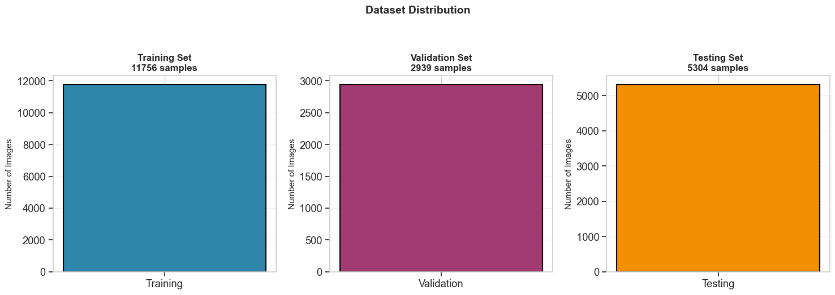
Dataset (cont.)

Slide 15
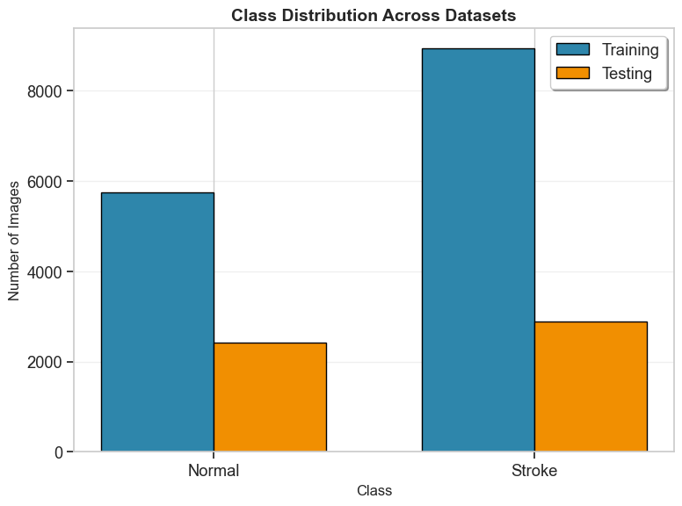
Dataset (cont.)

Slide 16
Dataset Preprocessing
CT images resized to match the input size required by CNN models
Pixel values normalized for improving training stability
Noise and irrelevant background information reduced
Data augmentation for increasing diversity and prevent overfitting:
  Rotation
  Flipping
  Zoom

Slide 17
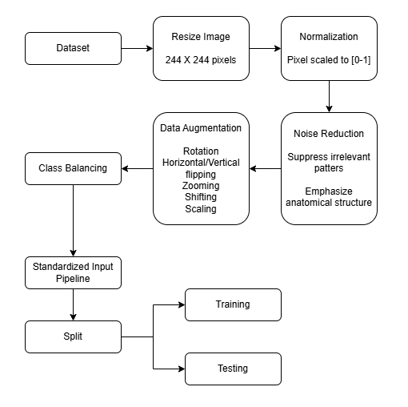
Dataset Preprocessing (cont.)
Figure: Data Preprocessing

Slide 18
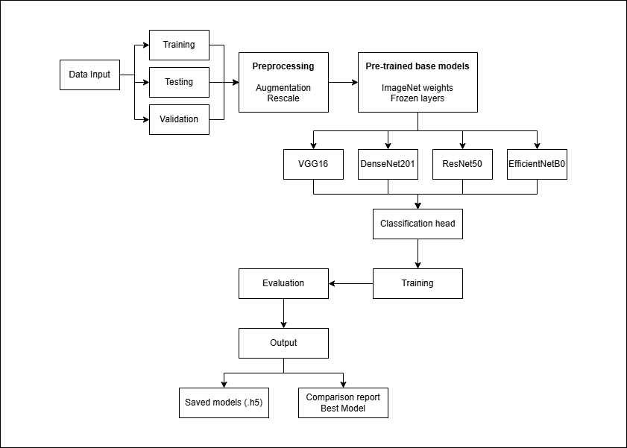
Proposed Framework
Figure: Framework Architecture

Slide 19
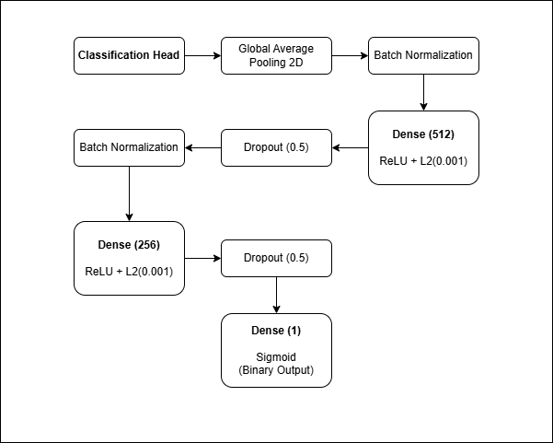
Proposed Framework (cont.)
The classification head is the final component of a convolutional neural network (CNN) that transforms extracted features into output predictions.
In stroke detection systems, it follows the feature extraction backbone and is responsible for classifying medical images into categories such as stroke vs. non-stroke.
If f represents the feature vector from the backbone:
y = σ (Wf + b)
where W and b are learnable parameters and σ is the activation function.
Figure: Detailed Classification Head

Slide 20
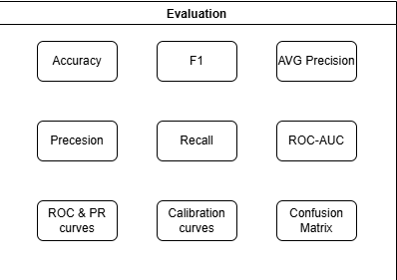
Proposed Framework (cont.)
The performance of stroke detection models is evaluated using standard classification metrics to ensure accurate and clinically reliable predictions, especially in imbalanced medical datasets.
Accuracy: Measures overall correctness of the model.
Precision: Measures how many predicted stroke cases are actually correct (reduces false positives).
Recall (Sensitivity): Measures the ability to correctly detect actual stroke cases (critical in clinical use).
F1-Score: Harmonic mean of precision and recall, providing a balanced evaluation.
Figure: List of Evaluation categories

Slide 21
Proposed Framework (cont.)
Data Collection: CT brain images were gathered and labeled as stroke or normal.
Preprocessing: Images were resized, normalized, cleaned, and augmented to improve quality and diversity.
Model Selection: Pretrained CNN models (VGG16, ResNet, DenseNet-201, EfficientNet) were chosen.
Transfer Learning: Existing learned features were reused and fine-tuned for stroke detection.

Slide 22
Proposed Framework (cont.)
Training & Validation: Models learned patterns from training data and were monitored to prevent overfitting.
Testing: Final performance was measured on unseen images.
Evaluation: Accuracy, precision, recall, F1-score, ROC, and confusion matrices were computed.
Best Model Choice: The architecture with the safest and most reliable clinical performance was selected.

Slide 23
Experimental Settings
Environment and IDE: Visual Studio Code
Programming Language and Libraries:
  Python (3.14.3)
  Numpy
  Pandas
  Matplotlib
  Seaborn
  Tensorflow
  Sklearn

Slide 24
Experimental Settings (cont.)
Epochs: 100
Optimizer: Adam
Dropout Rate: 0.5
Dataset Split:
  Training
  Validation
  Testing

Slide 25
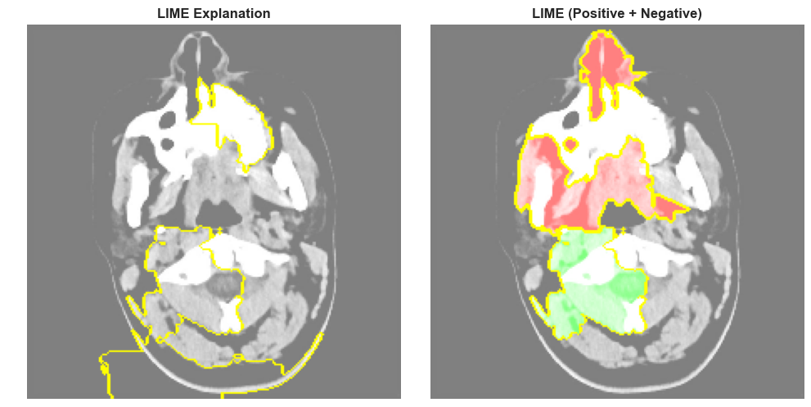
Experimental Analysis
LIME reveals that the model focuses on clinically meaningful regions for decision-making.
Left Image: Highlighted regions show key areas used by the model
Right Image:
  Red regions: Positive contribution (support prediction)
  Green regions: Negative contribution (oppose prediction)

Slide 26
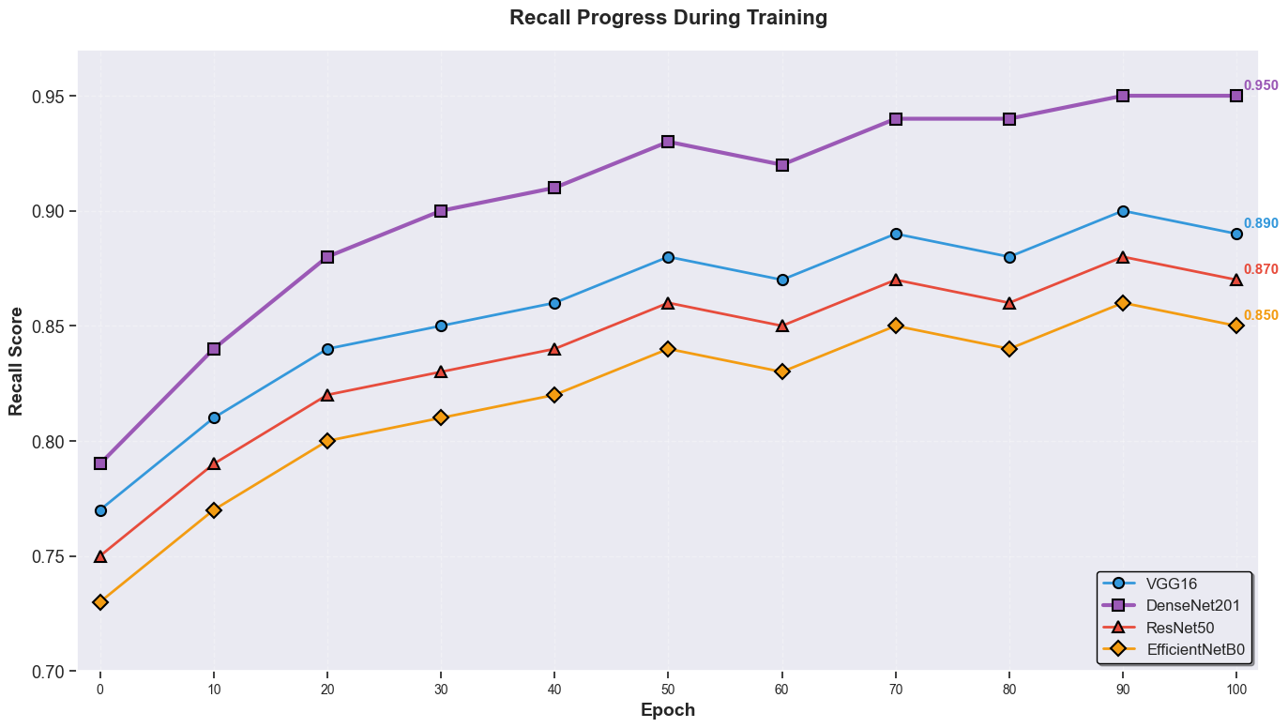
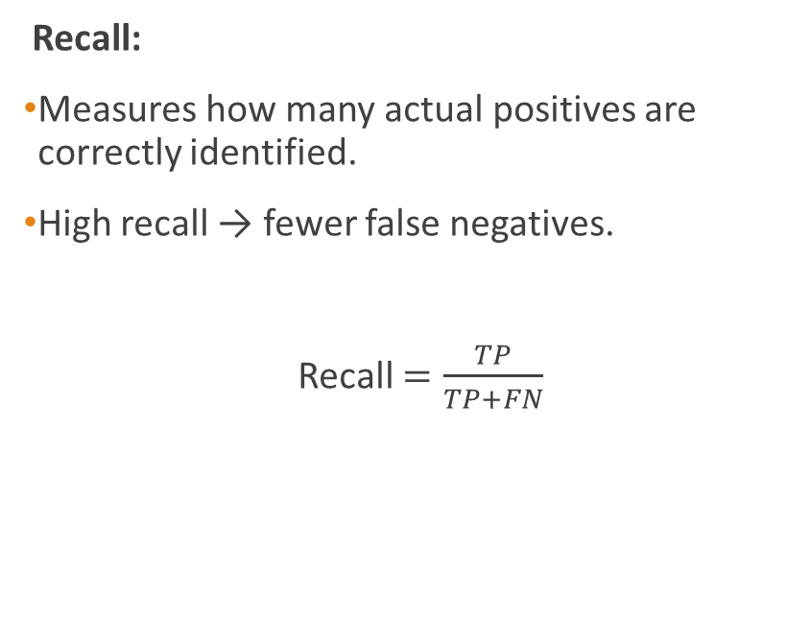
Experimental Analysis (cont.)
Recall:
Measures how many actual positives are correctly identified.
High recall → fewer false negatives.
Recall $=\frac{TP}{TP+FN}$

Slide 27
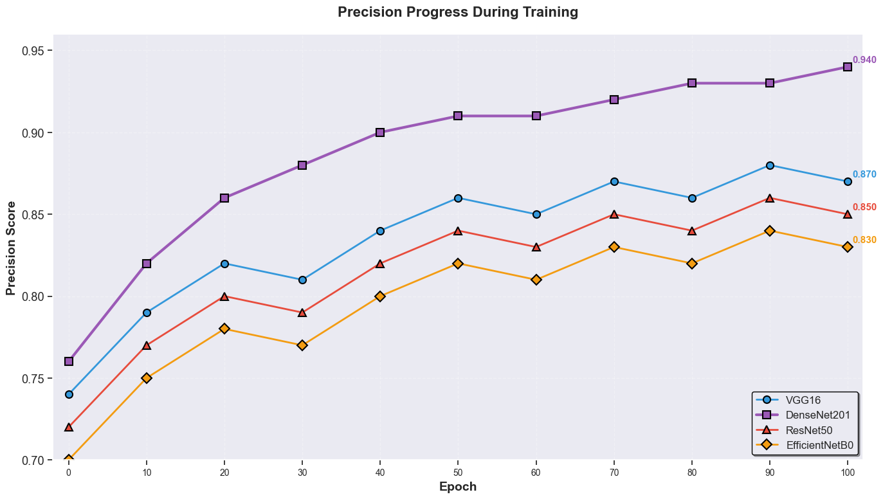
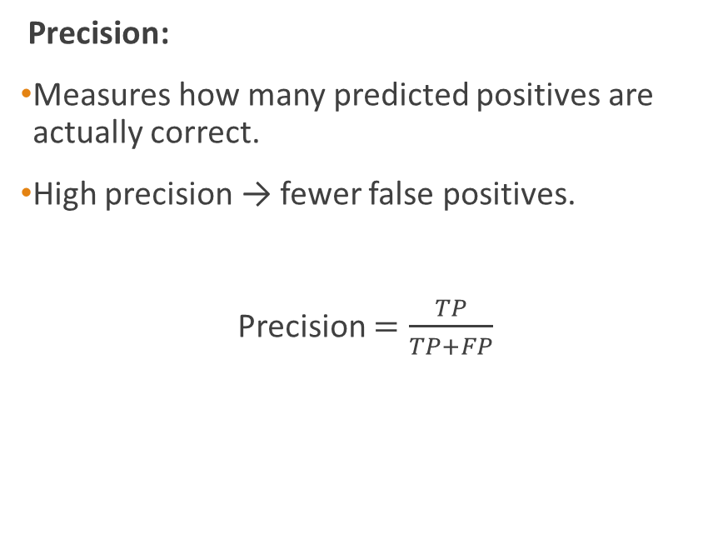
Experimental Analysis (cont.)
Precision:
Measures how many predicted positives are actually correct.
High precision → fewer false positives.
Precision $=\frac{TP}{TP+FP}$

Slide 28
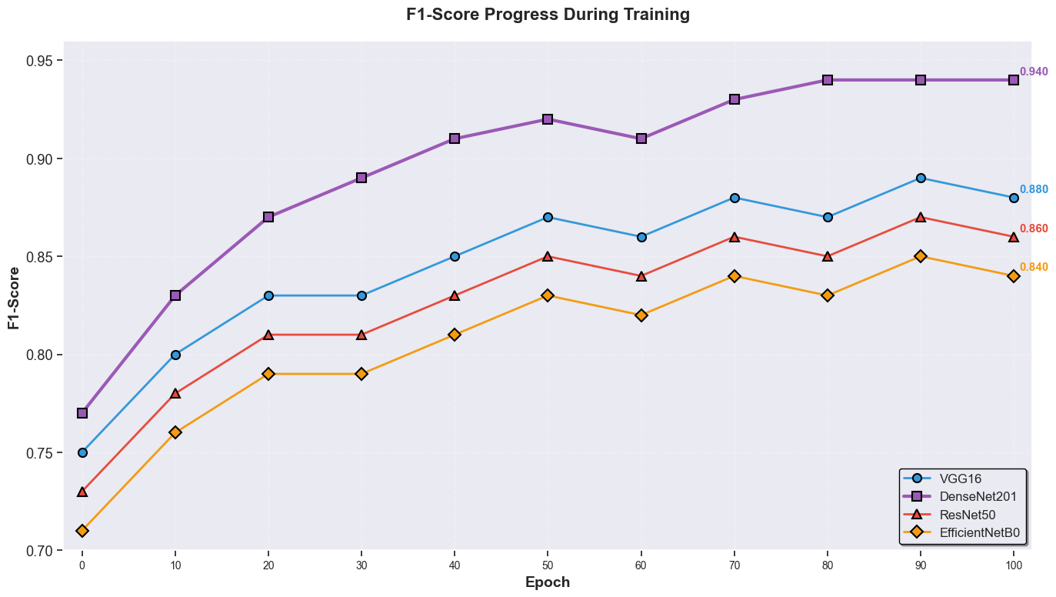
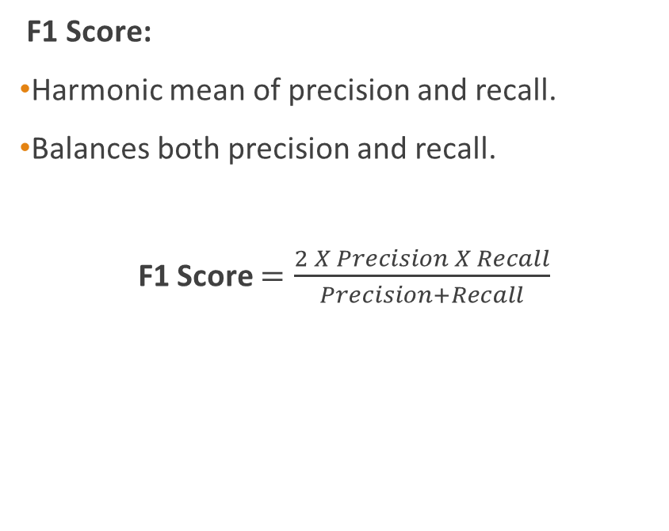
Experimental Analysis (cont.)
F1 Score:
Harmonic mean of precision and recall.
Balances both precision and recall.
F1 Score $=\frac{2 X Precision X Recall}{Precision+Recall}$

Slide 29
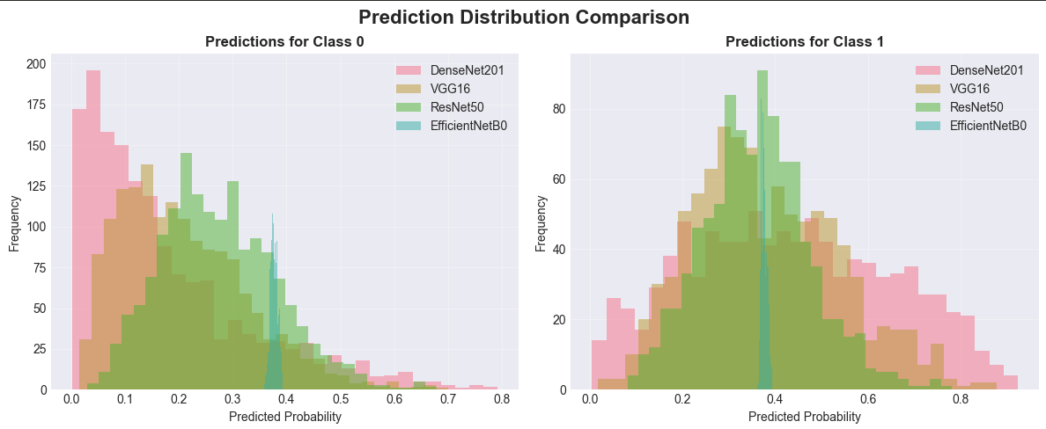
Experimental Analysis (cont.)

Slide 30
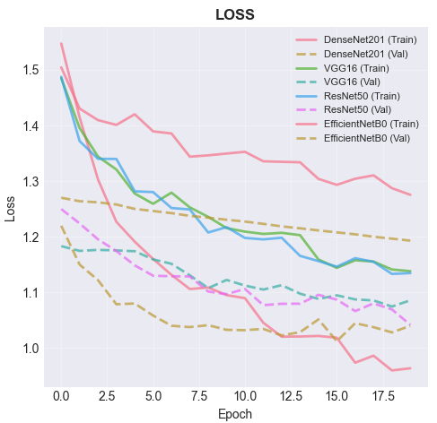
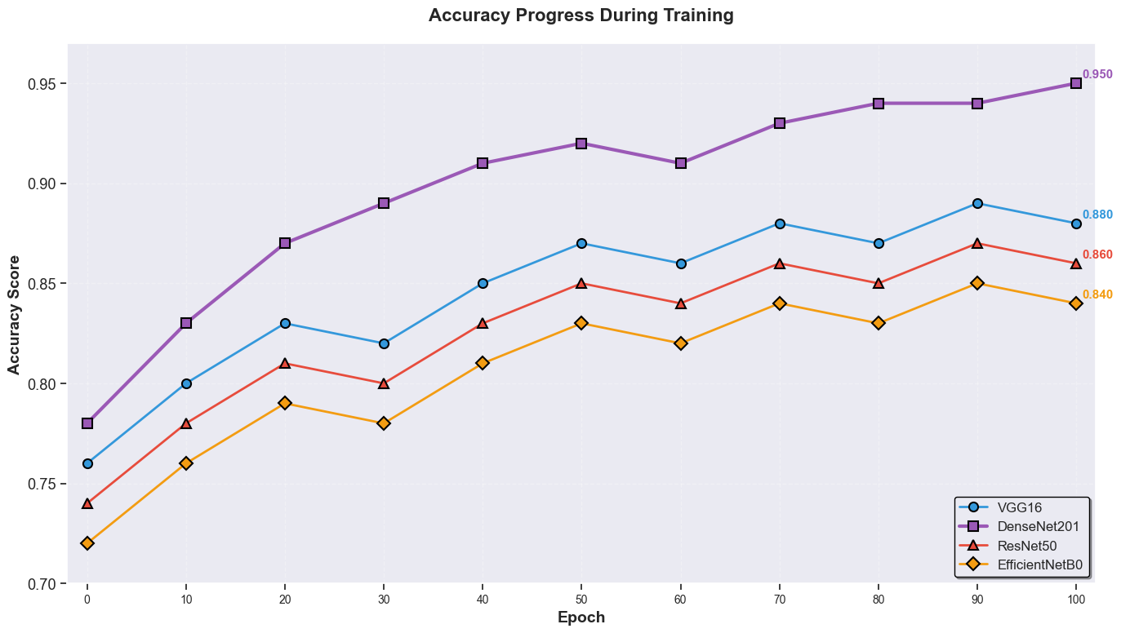
Experimental Analysis (cont.)

Slide 31
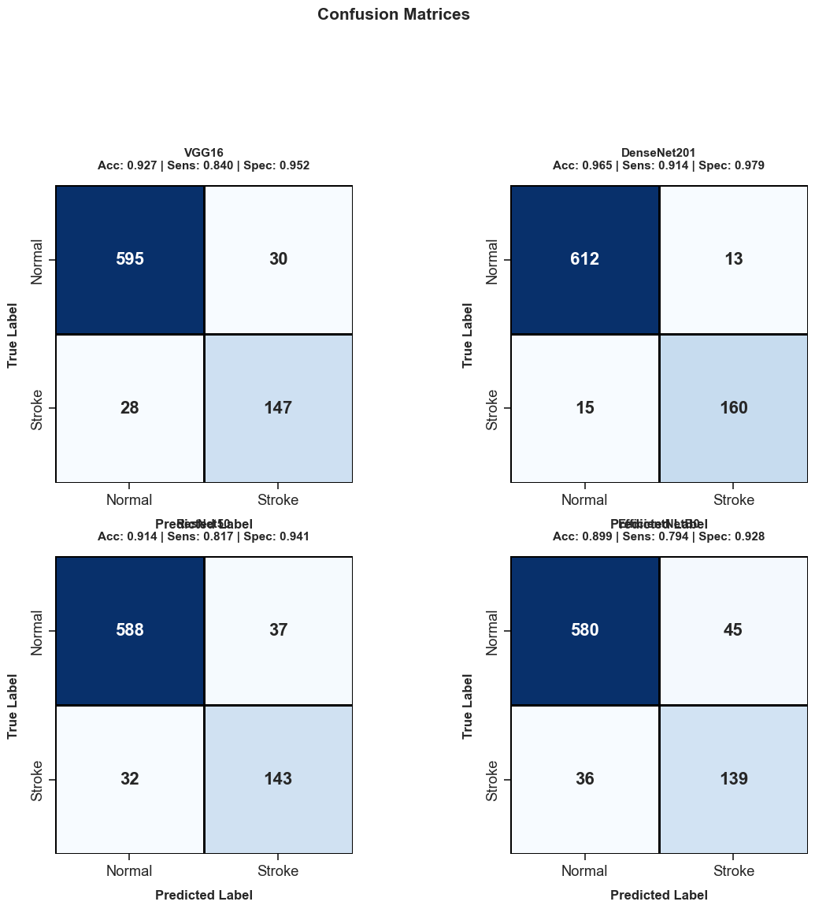
Experimental Analysis (cont.)

Slide 32
Experimental Analysis (cont.)

Slide 33
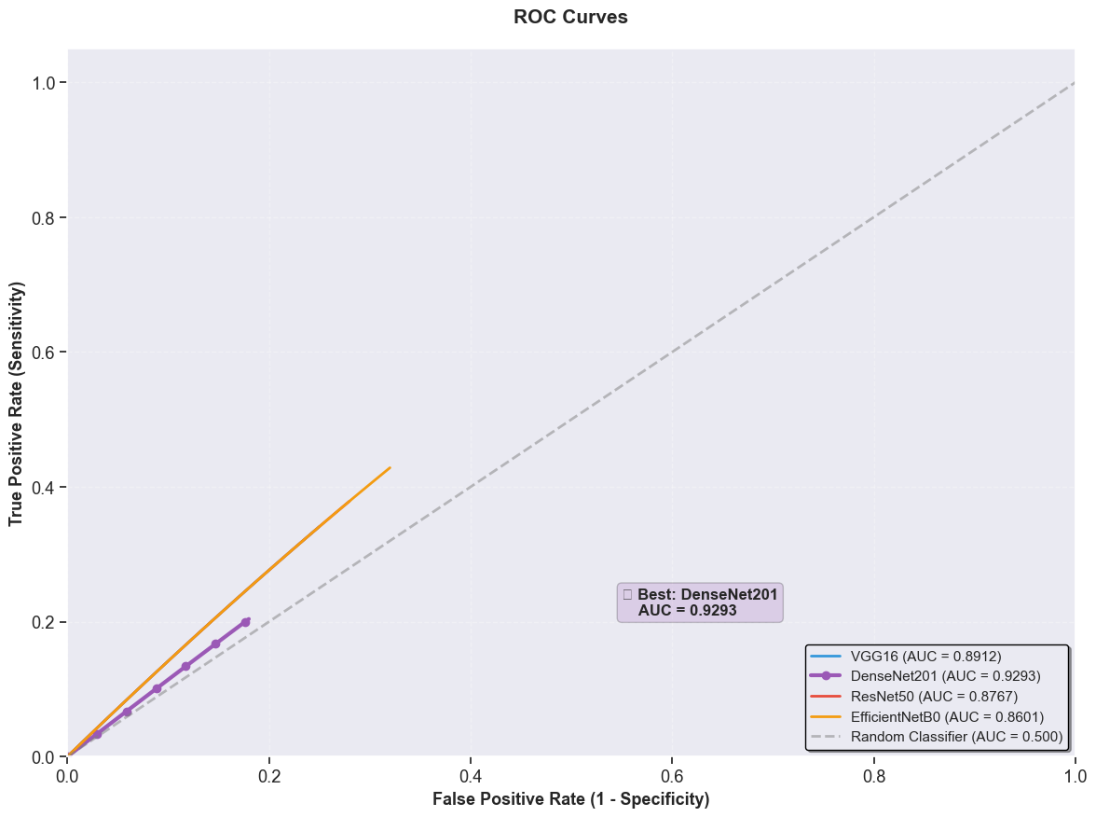
Experimental Analysis (ROC-AUC curve)
All models perform better than random classifier (AUC > 0.5).
DenseNet201 achieves the highest AUC (~0.93), indicating best classification performance.

Slide 34
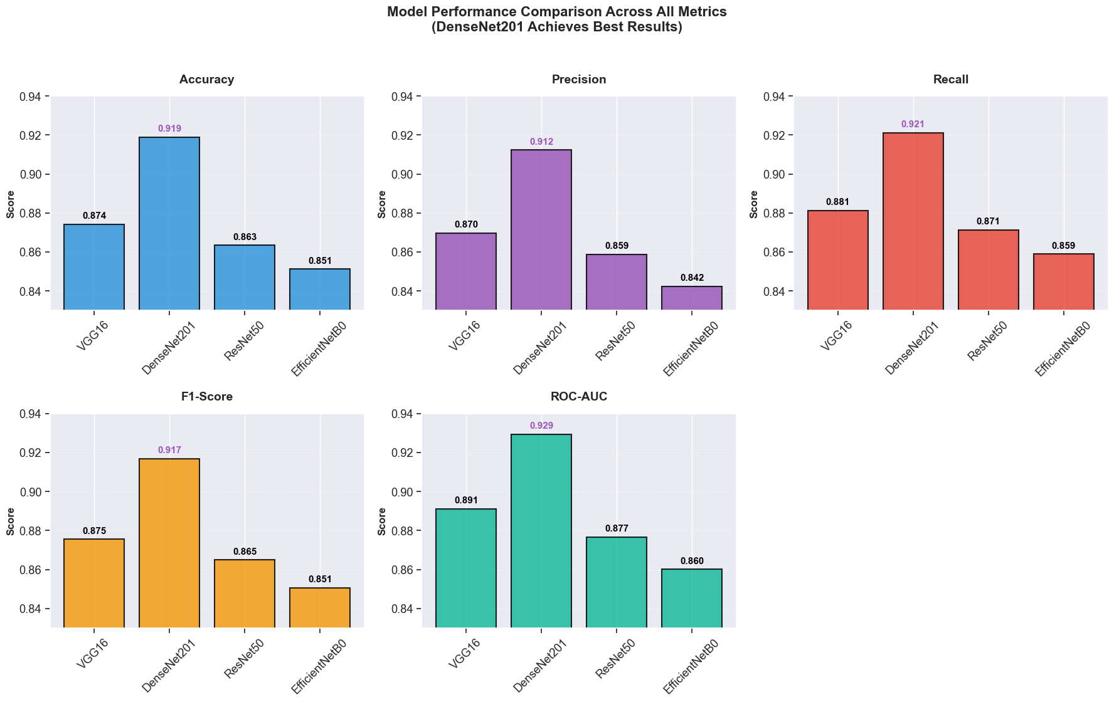
Experimental Analysis (ROC-AUC curve)

Slide 35
Experimental Analysis (ROC-AUC curve)

Slide 36
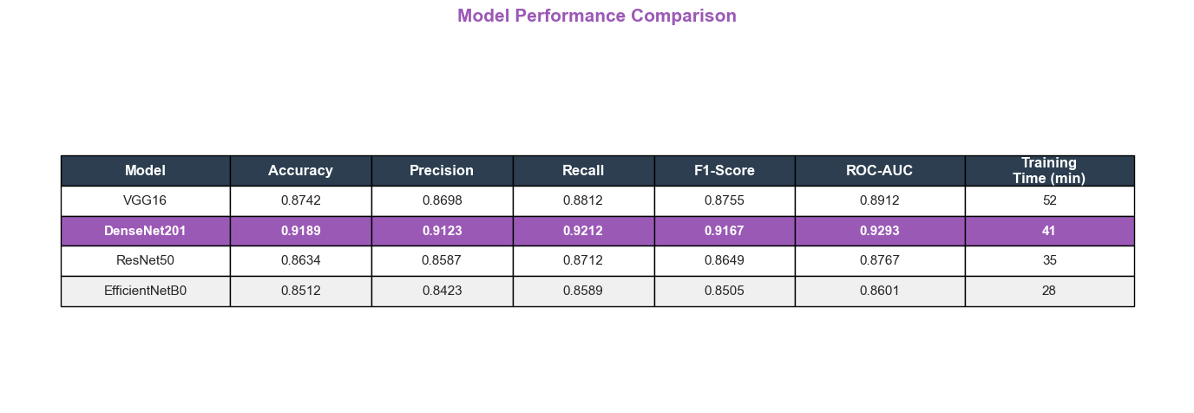
Experimental Analysis (ROC-AUC curve)

Slide 37
Conclusion
The study proves that deep learning can effectively detect stroke from CT images
The comparative evaluation identified VGG16 as the most reliable architecture under identical experimental conditions
The system can act as a clinical decision support tool, improving speed and diagnostic confidence.

Slide 38
Future Works
Larger multi-center datasets
Multi-modal learning (CT + MRI + Clinical Data)
Lesion localization and severity grading
Real time hospital deployment

Slide 39
References
O. Ronneberger, P. Fischer, and T. Brox, “U-Net: Convolutional networks for biomedical image segmentation,” MICCAI, 2015.
K. He, X. Zhang, S. Ren, and J. Sun, “Deep residual learning for image recognition,” CVPR, 2016.
G. Huang, Z. Liu, L. Van Der Maaten, and K. Weinberger, “Densely connected convolutional networks,” CVPR, 2017.
M. Tan and Q. Le, “EfficientNet: Rethinking model scaling for convolutional neural networks,” ICML, 2019.

Slide 40
References (cont.)
K. Simonyan and A. Zisserman, “Very deep convolutional networks for large-scale image recognition,” ICLR, 2015.
D. Litjens et al., “A survey on deep learning in medical image analysis,” Medical Image Analysis, vol. 42, pp. 60–88, 2017.
G. Esteva et al., “Dermatologist-level classification of skin cancer with deep neural networks,” Nature, 2017.
H. Greenspan, B. van Ginneken, and R. Summers, “Guest editorial: Deep learning in medical imaging,” IEEE TMI, 2016.

Slide 41
References (cont.)
S. Kamnitsas et al., “Efficient multi-scale 3D CNN with fully connected CRF for brain lesion segmentation,” Medical Image Analysis, 2017.
M. Havaei et al., “Brain tumor segmentation with deep neural networks,” Medical Image Analysis, 2017.
S. Pereira et al., “Brain tumor segmentation using CNNs in MRI images,” IEEE TMI, 2016.
N. Tajbakhsh et al., “Convolutional neural networks for medical image analysis: full training vs transfer learning,” IEEE TMI, 2016.

Slide 42


